Slide 1







Employee Data Analysis using Excel
STUDENT NAME :
REGISTER NO :
NM user id :
DEPARTMENT : B.Com General
COLLEGE : SHRI KRISHNASWAMY COLLEGE FOR WOMEN
PAVITHRA.B
312217211
139C30A72E8FD3CA8EC4FF68A0D61415
1
Notes:
1.7.2013
1
‹#›

Slide 2





PROJECT TITLE
VISUALIZING EMPLOYEE ATTENDANCE TRENDS WITH EXCEL CHARTS
2
Notes:
1.7.2013
2
‹#›

Slide 3





AGENDA
Problem Statement
Project Overview
End Users
Our Solution and Proposition
Dataset Description
Modelling Approach
Results and Discussion
Conclusion
3
3/21/2024 Annual Review

Slide 4

PROBLEM STATEMENT
Employee attendance is a crucial metric for any organization, influencing productivity, planning, and overall operational efficiency. Regular monitoring and analysis of attendance data help in identifying patterns, potential issues, and areas for improvement. Visualizing this data through charts can provide clearer insights and aid in decision-making.
Objective
To create an effective system for visualizing employee attendance trends using Excel charts, enabling managers to easily interpret attendance patterns, identify trends, and make data-driven decisions.
Requirements
Data Collection and Preparation:
Collect attendance data for employees, including attributes such as dates, employee
IDs, names, attendance status Chart Types and Visualization:
Develop various types of charts to visualize attendance trends, including but
not limited to:
Line Charts: To show attendance trends over time for individual employees
or teams.
Bar Charts: To compare attendance rates across different departments or
time periods.
Pie Charts: To represent the proportion of different attendance statuses
Heat Maps: To highlight periods of high or low attendance.
4

Slide 5

PROJECT OVERVIEW
The project aims to develop an Excel-based solution for visualizing employee attendance data, providing managers and HR professionals with intuitive charts and interactive tools to analyze attendance patterns, identify trends, and make data-driven decisions.
Project Goals
Effective Visualization: Create a suite of Excel charts that clearly represent attendance trends, facilitating easy interpretation of data.
Interactive Features: Implement interactive elements to allow users to explore data dynamically and generate custom views based on their needs.
Data Analysis: Enable detailed analysis of attendance patterns to support decision-making processes and improve organizational efficiency.
.
5

Slide 6

WHO ARE THE END USERS?
1. HR Managers and HR Personnel
2. Department Managers and Team Leads
3. Executives and Senior Leadership
4. Data Analysts and Reporting Specialists
5. Payroll Specialists
6. Employees (for Self-Monitoring)
7. IT Support Staff
6

Slide 7

OUR SOLUTION AND ITS VALUE PROPOSITION
Solution and Value: Visualizing Employee Attendance Trends with Excel Charts
Solution Overview
Our solution provides a comprehensive Excel-based system designed to visualize employee attendance trends through a variety of interactive charts and tools. This solution enables users to effectively monitor, analyze, and report on attendance data, facilitating data-driven decision-making and improving overall workforce management.
Documentation and Support:
User Guide: Detailed documentation on how to use the Excel workbook, including chart customization, data updates, and report generation.
Training Materials: Provide training resources or sessions to ensure users can effectively utilize the solution.
Value Proposition
Enhanced Decision-Making:
Data-Driven Insights: Clear visualization of attendance trends helps managers and HR professionals make informed decisions based on real-time data.
Identifying Patterns: Easily spot attendance patterns, peak absence periods, and potential issues, allowing for proactive management and interventions.
Improved Efficiency:
Streamlined Reporting: Automated and customizable reports save time and reduce manual effort in preparing attendance summaries.
Interactive Features: Real-time data exploration and filtering enhance users' ability to quickly access relevant information.
7

Slide 8
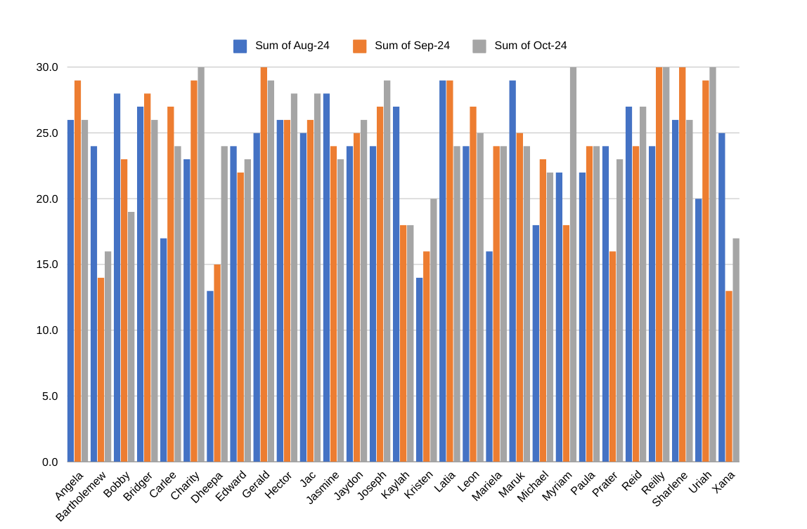
Dataset Description
EmpID | (All)
 | Values
FirstName | Sum of Aug-24 | Sum of Sep-24 | Sum of Oct-24
Angela | 26 | 29 | 26
Bartholemew | 24 | 14 | 16
Bobby | 28 | 23 | 19
Bridger | 27 | 28 | 26
Carlee | 17 | 27 | 24
Charity | 23 | 29 | 30
Dheepa | 13 | 15 | 24
Edward | 24 | 22 | 23
Gerald | 25 | 30 | 29
Hector | 26 | 26 | 28
Jac | 25 | 26 | 28
Jasmine | 28 | 24 | 23
Jaydon | 24 | 25 | 26
Joseph | 24 | 27 | 29
Kaylah | 27 | 18 | 18
Kristen | 14 | 16 | 20
Latia | 29 | 29 | 24
Leon | 24 | 27 | 25
Mariela | 16 | 24 | 24
Maruk | 29 | 25 | 24
Michael | 18 | 23 | 22
Myriam | 22 | 18 | 30
Paula | 22 | 24 | 24
Prater | 24 | 16 | 23
Reid | 27 | 24 | 27
Reilly | 24 | 30 | 30
Sharlene | 26 | 30 | 26
Uriah | 20 | 29 | 30
Xana | 25 | 13 | 17
Grand Total | 681 | 691 | 715

Slide 9

THE "WOW" IN OUR SOLUTION
1. Dynamic Interactivity
Real-Time Data Exploration: Users can interact with charts through slicers and drop-down menus to filter and view data in real-time. This dynamic interaction allows users to drill down into specific time periods, departments, or individual employees instantly, providing a personalized and detailed analysis of attendance trends.
2. Comprehensive Visualization Suite
Diverse Chart Types: The solution offers a broad range of visualizations, including line charts, bar charts, pie charts, and heat maps. This variety allows users to choose the best chart type for their specific analysis, whether they’re tracking long-term trends, comparing departmental attendance, or understanding status distributions.
3. Enhanced User Experience
Intuitive Design: The solution is designed with user-friendliness in mind. Clear labels, guided instructions, and easy-to-navigate interfaces ensure that users with varying levels of Excel proficiency can effectively utilize the tool.
4. Powerful Analytical Capabilities
Automated Insights: Built-in analytical tools generate summary reports and key insights automatically, reducing the need for manual data analysis and enhancing decision-making efficiency.
5. Scalability and Adaptability
Flexible Data Integration: The solution is adaptable to different scales and can handle large datasets without compromising performance. It also allows for easy updates and integration of new data, making it a future-proof investment.
3/21/2024 Annual Review
9

Slide 10
MODELLING
Effective modeling is essential for creating a robust and insightful Excel-based solution for visualizing employee attendance trends. Below, we outline the key components of this modeling process, including data structure, chart selection, and interactivity.
Key modelling factors :
1. Data Structure and Preparation
2. Chart Selection and Design
3. Interactivity and User Experience
4. Analysis and Reporting
5. Documentation and Training
10

Slide 11
RESULTS
Results that enhance organizational efficiency, decision-making, and employee engagement. Here’s an overview of the key results:
Enhanced Data Insights
Clear Trend Visualization:
Outcome: Pie charts and heat maps illustrate the distribution of attendance statuses (e.g., present, absent, late) and highlight periods of high or low attendance.
. Improved Decision-Making
Data-Driven Decisions:
Outcome: Executives and managers can use visualized data to make informed decisions regarding workforce management, policy changes, and operational adjustments.
11

Slide 12
conclusion
Visualizing employee attendance trends with Excel charts represents a transformative approach to managing and understanding workforce attendance. By leveraging Excel’s robust charting capabilities, organizations gain a powerful tool for turning raw attendance data into actionable insights. The solution not only enhances data clarity but also supports strategic decision-making and operational efficiency.
This approach not only enhances operational efficiency but also fosters a culture of transparency and accountability, ultimately contributing to a more engaged and productive workforce.

